Slide 1
License Plate Detection and Recognition
Team members:
Karthik Boddupalli
Mudavath Bhanu Prakash
Project overview
- 19 Apr ‘23

Slide 2
Looking at the bigger picture
License plate detection and recognition (LPDR):
As the name suggests, we have two clear objectives:-
1. License plate detection (Object detection)
2. Character Recognition (letters & numbers from the plate obtained above)
But in order to do any of this, we need DATA i.e., images of vehicles along with their license plates.

Slide 3
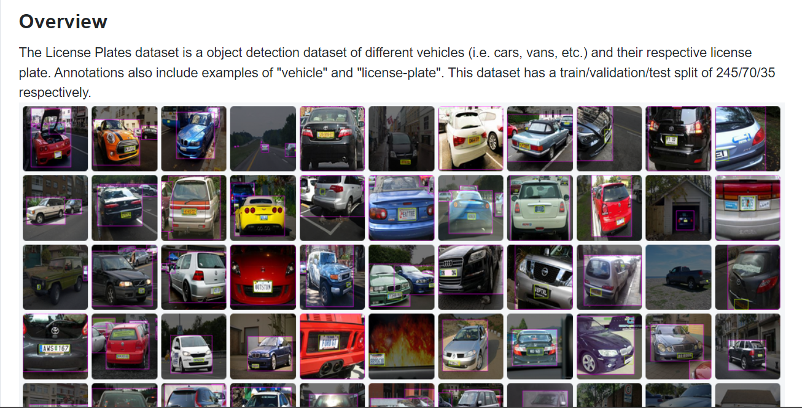
1. Data Collection and Pre-processing
After a pretty tiring research, we were able to find a dataset that best suits our requirements i.e., properly structured and labelled data

Slide 4
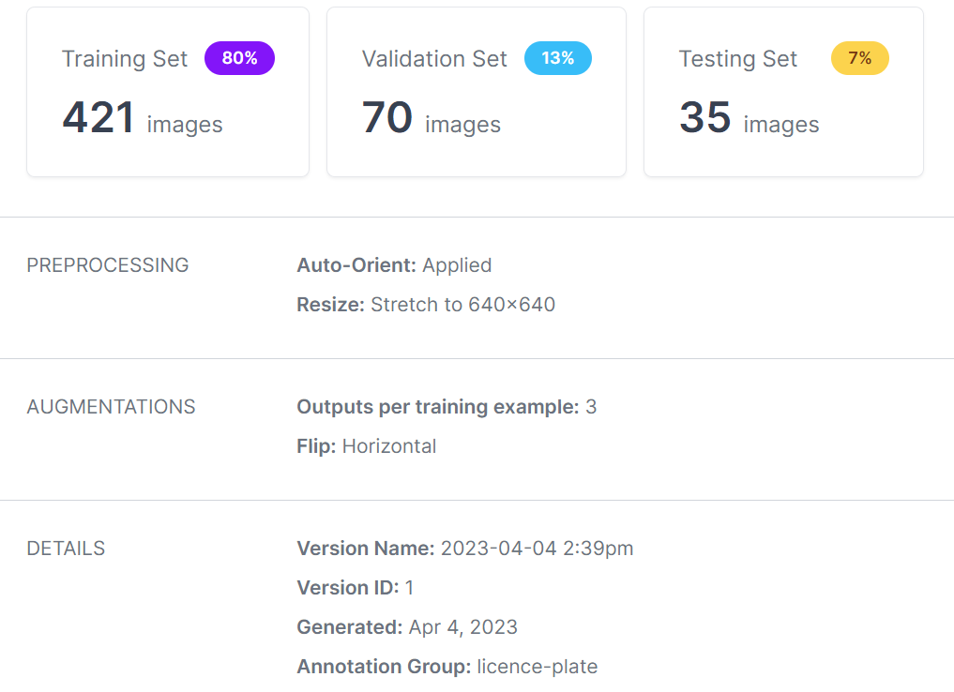
1. Data Collection and Pre-processing
Given dataset contains about 350 images but that’s not good enough
Not all image files have same resolution (i.e., length and width) but we need 640x640 as standard input for YOLOv8.
So, we need to pre-process the data by making:
1. Resizing images to a particular resolution that will be accepted by our “object detection model”.
2. Performing few augmentations like Horizontal flip to increase the dataset.

Slide 5
2. Study & Understanding of Algorithm
Now that we have our data, it’s time to use it. But how?
As said earlier, we need to 1) Detect the license plate in an image and then
2) Recognize the characters in it.
First let’s see how we can detect the license plate. This can be done by developing an “Object detection model using YOLO algorithm ”.
In the subsequent slides, we’ll see how this algorithm works.

Slide 6
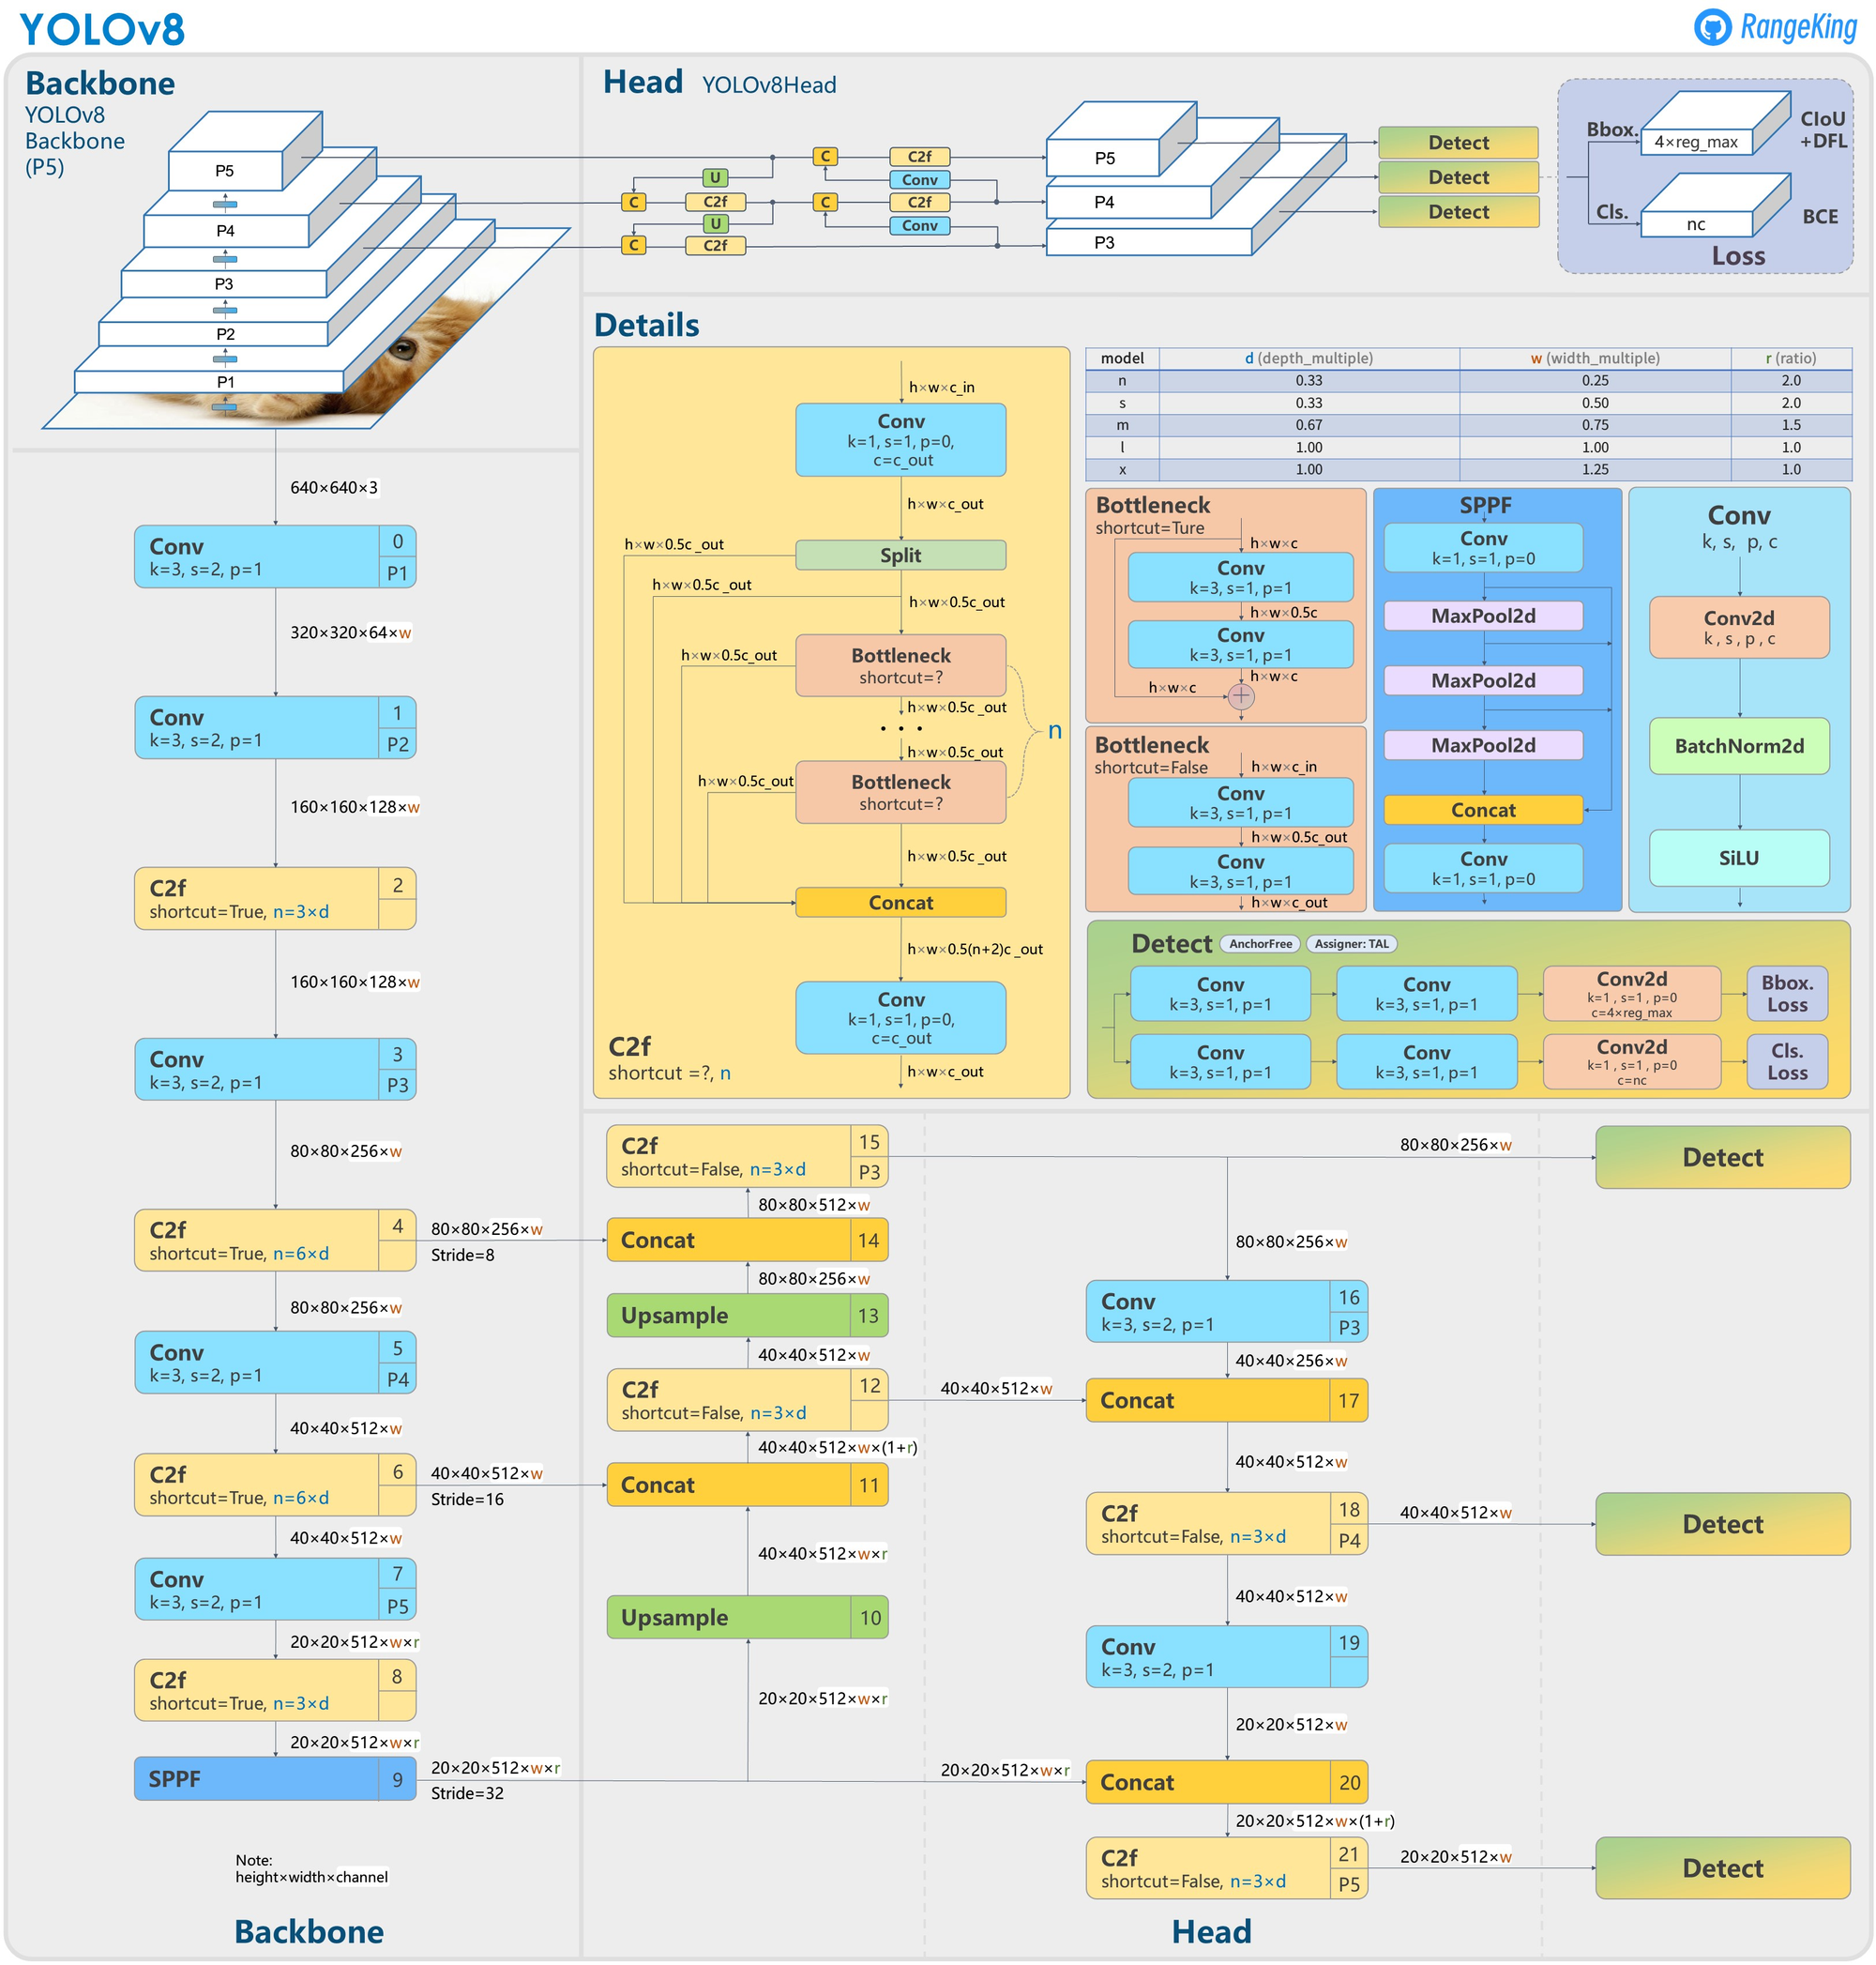
YOLO Algorithm – Architecture:
YOLO (You Only Look Once) is a CNN based algorithm used to detect objects (i.e., region of interests) from an image.
The latest industrial standard of this algorithm is the YOLO v8 developed by Ultralytics.
YOLOv8 architecture has 225 layers, 11136374 parameters.
This consists of a backbone which extracts features from an image and the head plays role in the detection phase i.e., giving bounding box using the extracted features.

Slide 7
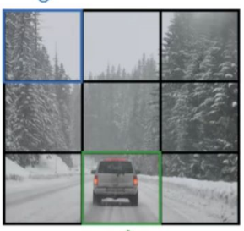
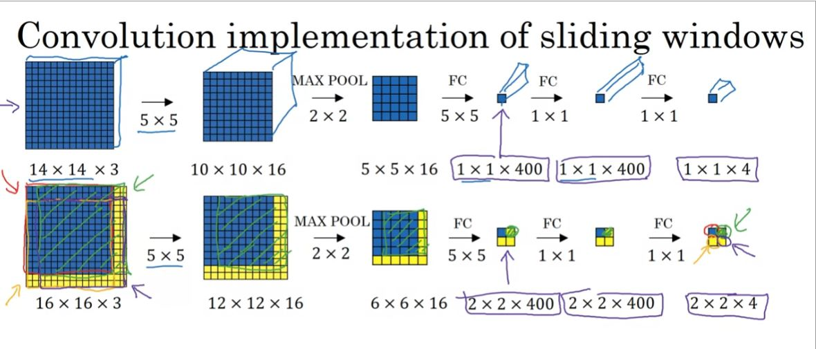
How this works?
(Object Detection Example)
First the given image is divided into several parts/frames.
Now in each frame, we try to detect the object using the sliding window approach:

Slide 8
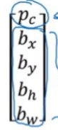
Convolution Implementation of Sliding windows:
A frame (image) is fed into the above CNN. First it’ll be passed through a conv.net (using say a 5x5 filter) to extract the features from it. Then it’ll be sent through a MAXPOOL which reduces the image size but not the channels.
This will be repeated several times extracting one feature at a time. Finally we’ll be left with a 1x1xn which will be fed into a Fully Connected NN (can be implemented using CNN only) as the input layer.
Now just like in an ANN, this i/p layer will be passed through conv. layers (adjusting weights) and finally through a ‘softmax function’ to reach the output layer which will be 1x1x5 as shown in the fig.
- Bounding Box (p_{c} -probability of presence of obj., (b_{x} b_{y}) co-ordinates of midpt. of bounding box, (b_{h} b_{w}) height and width of bounding box).

Slide 9
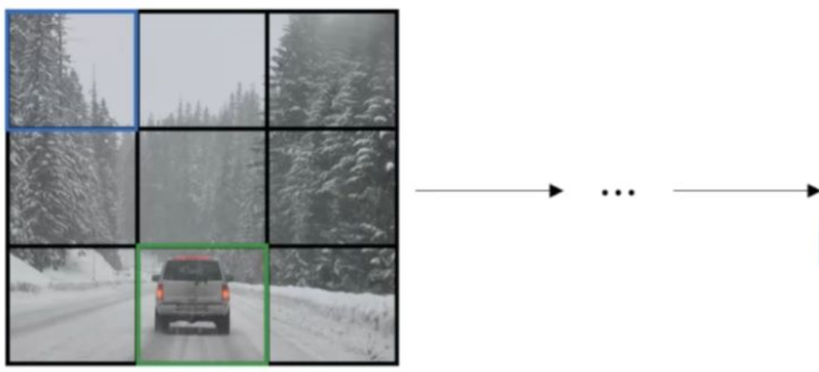

Convolution Implementation of Sliding windows:
Note that we don’t have to do the above process sequentially for each frame sized partition but can pass the whole image into the prev. CNN to get outputs corresponding to each frame in a matrix.

Slide 10
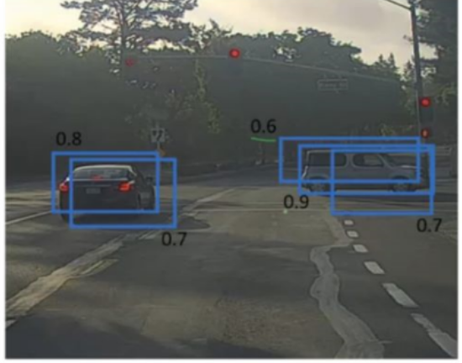
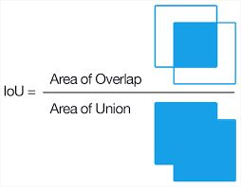
Non-max suppression:
Now after the said process is done, we’ll have several bounding boxes given by diff. frames. In order to chose the best one, we’ll follow NON-MAX SUPPRESSION:
1. Discard all boxes with p_{c} <= threshold_p (say 0.6)
2. Pick the box with largest p_{c} . Output that as a prediction.
3. Discard any remaining box with IoU >= 0.5 with the box output in the prev. step.
NOTE: IoU is defined as

Slide 11
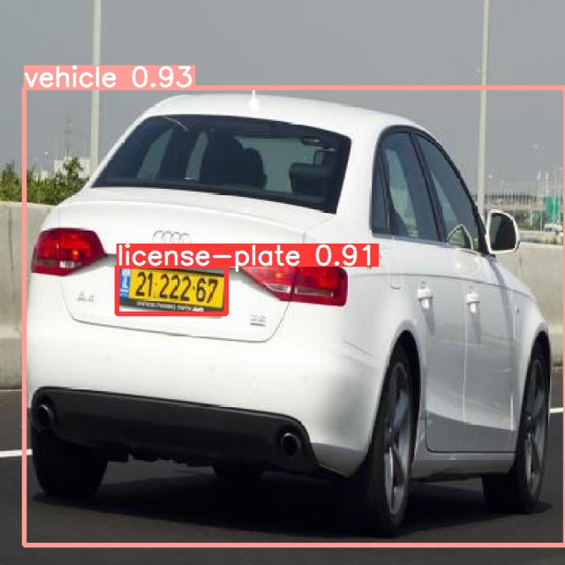
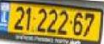
Final steps after detection
Now that we got a bounding box corresponding to our license plate, we can obtain the co-ordinates of the end-points of the license plate using our output vector (pc, bx, by, bh, bw).
After computing the co-ordinates, we extract the plate out of the image and scale it uniformly to an appropriate size which will be later used for recognition of characters present in it.
Now, that we obtained our “region of interest”, we now need to “recognize” each character present in it to get the license number.

Slide 12
Optical Character Recognition (OCR)
Text Recognition:
One of the most popular algorithm used for character recognition is ‘Feature Extraction or Patter Matching’:
Feature extraction (Pattern Matching)
Feature extraction breaks down or decomposes the glyphs (isolated character image) into features such as lines, closed loops, line direction, and line intersections. It then uses these features to find the best match or the nearest neighbor among its various stored glyphs.

Slide 13
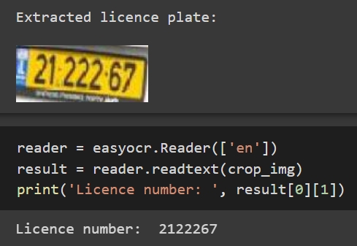
Optical Character Recognition (OCR)
EasyOCR:
EasyOCR is a Python library for Optical Character Recognition (OCR) that allows you to easily extract text from images and scanned documents.
We’ll be using EasyOCR to read the text from the detected licence plate in order to obtain the ‘text version’ of the licence number.

Slide 14
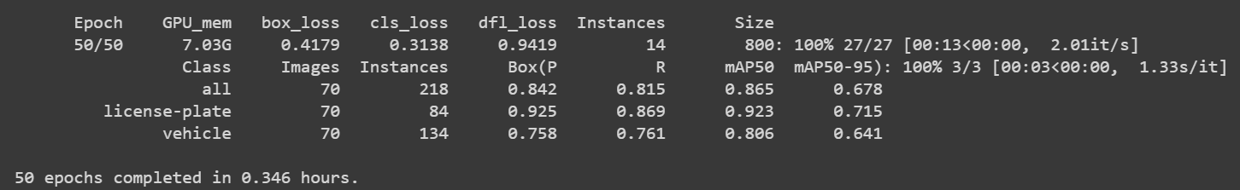
Loading and Training phase:
Now that we’ve seen how our algorithm works, it’s time to implement it on our dataset.
First, we load the YOLOv8 model (along with the pretrained weights) for object detection.
We train the loaded model on our custom dataset in order to make the model serve our purpose i.e., licence-plate detection.
We perform this on our ‘train-split’ of our dataset for 50 epochs as shown:

Slide 15
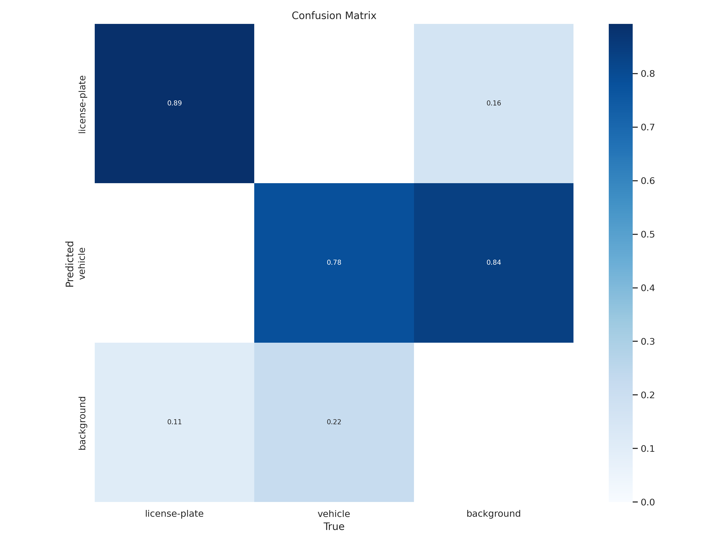
Performance Metrics: Confusion matrix
The suitable performance metric for our object-detection problem is the ‘Confusion Matrix’.
We can see that after training, our model is able to detect the licence plate correctly (True-Positive) 89% of the time i.e., around 90% accuracy.
Similarly, the same for object ‘vehicle’ is 0.78 (around 80%).

Slide 16
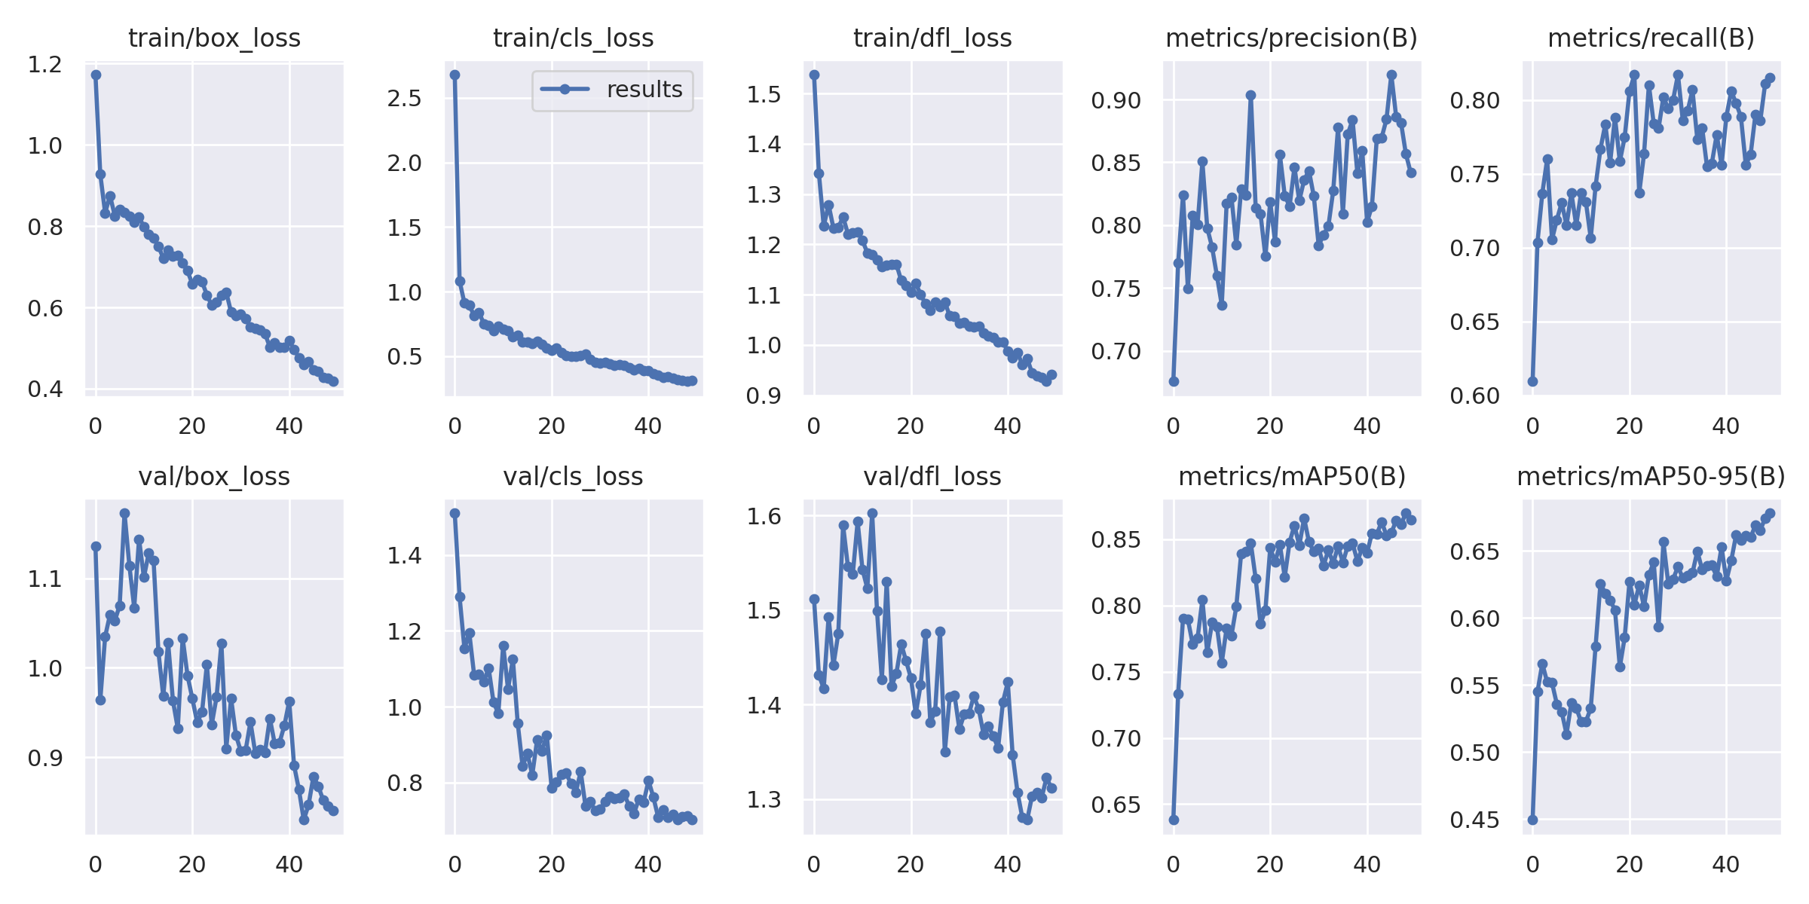
Performance Metrics: loss graphs
Also while training, we can see the losses (i.e., box_loss, cls_loss and dfl_loss) are decreased over each epoch and eventually converged.
This indicates that our model has ‘learned’ and is able to predict more accurately at the last few epochs.
Same applies for metric (precision) which gradually increased over each epoch.

Slide 17
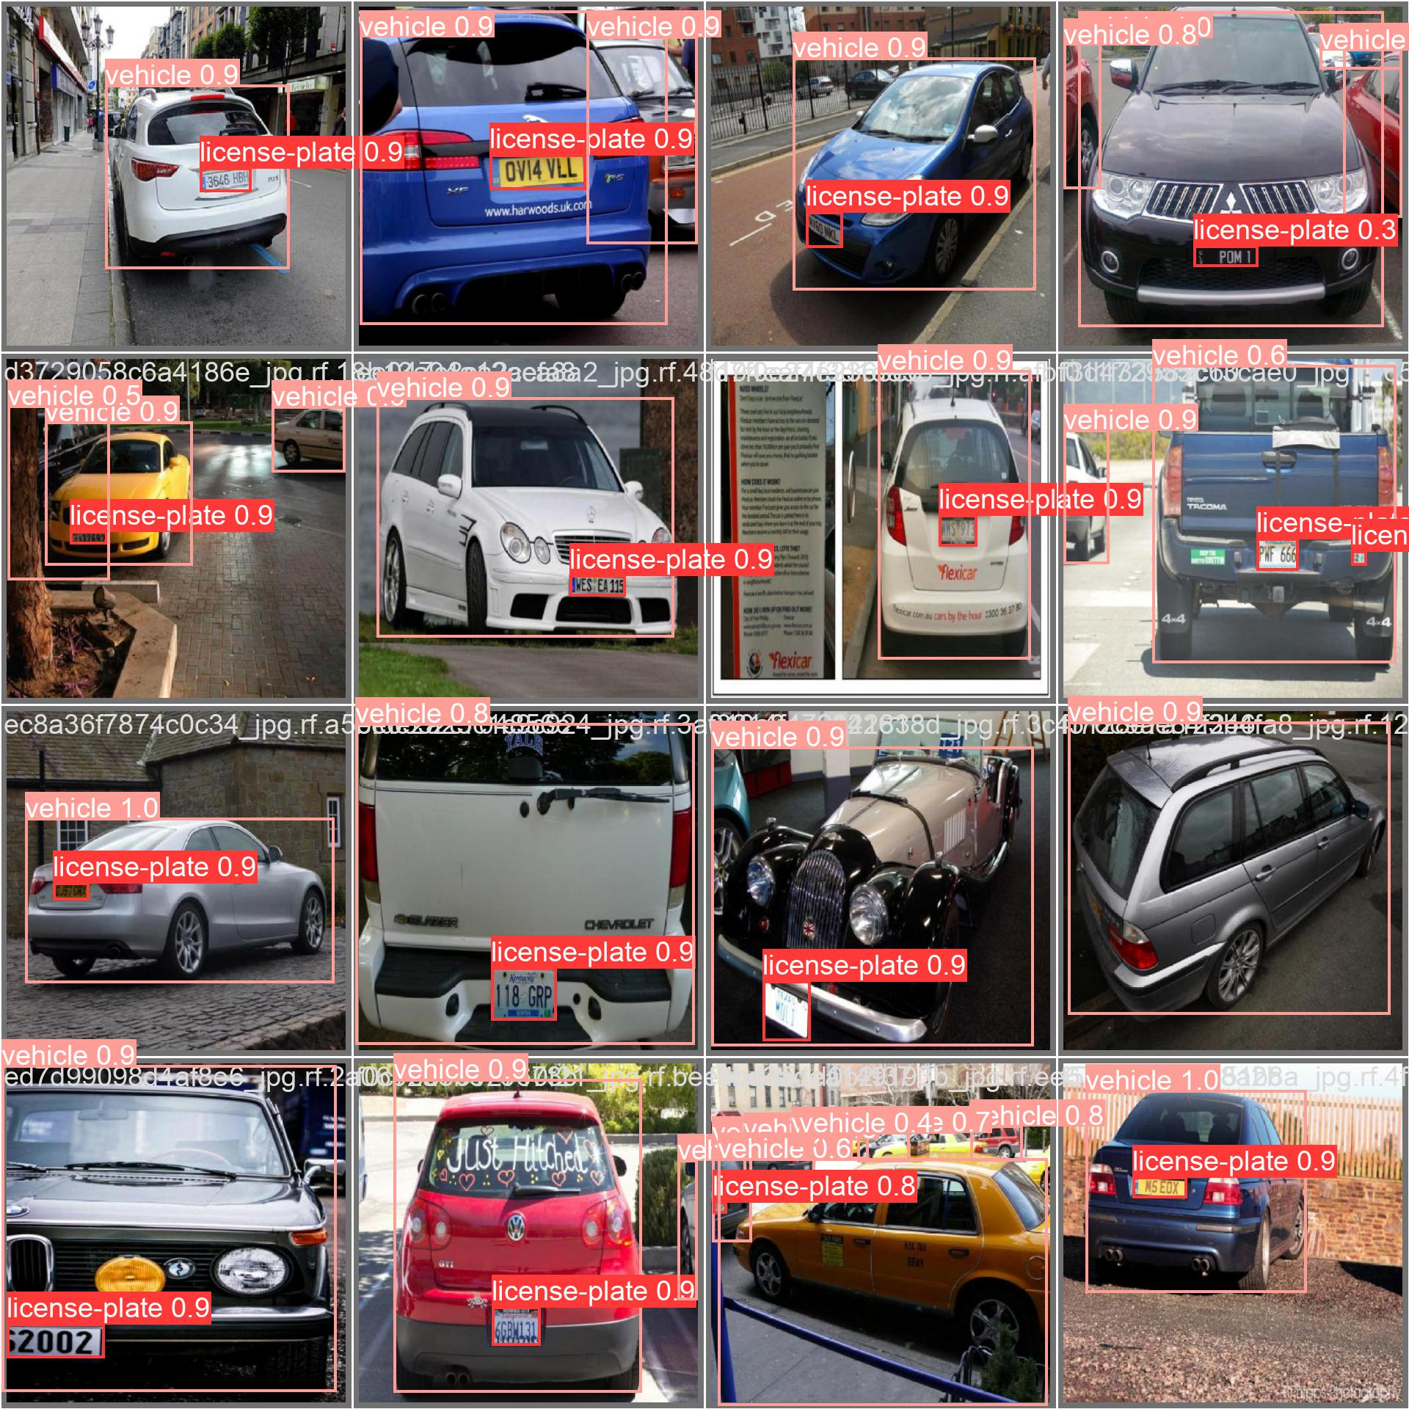
Validation
Now that we’ve trained our model. It’s time to validate it.
When we run detection on one of the validation batches, this is what we got.
We can see our model is able to predict both the vehicle and licence-plate pretty accurately.

Slide 18
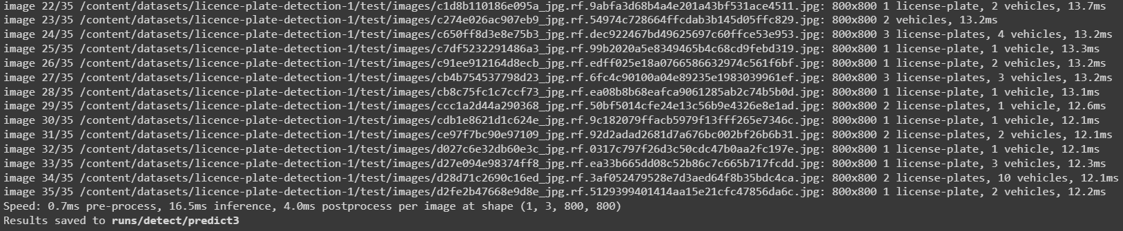
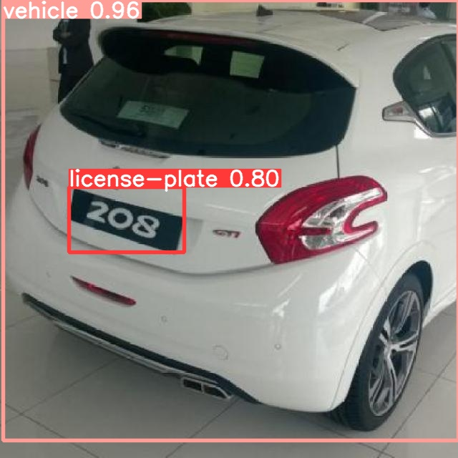
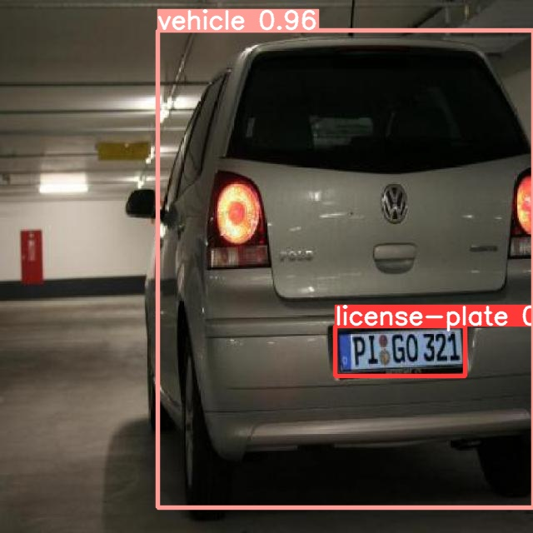
Testing phase: Images

Slide 19
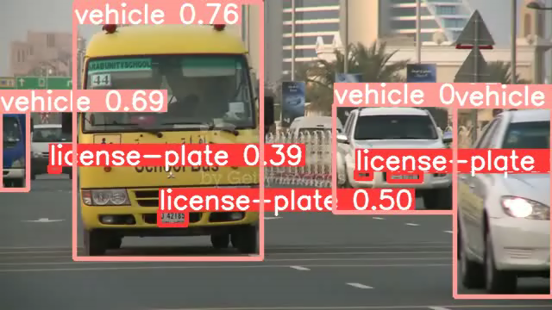
Testing phase: Video

Slide 20
Extracting bounding box
From our detection output, we can have the co-ordinates of the bounding box and we should extract/crop that part out of the image before passing it onto EasyOCR.

Slide 21
Applying Recognition (EasyOCR)
Now we can just pass on the ‘cropped_image’ into the easyocr.reader to obtain the text:

Slide 22


